Slide 1
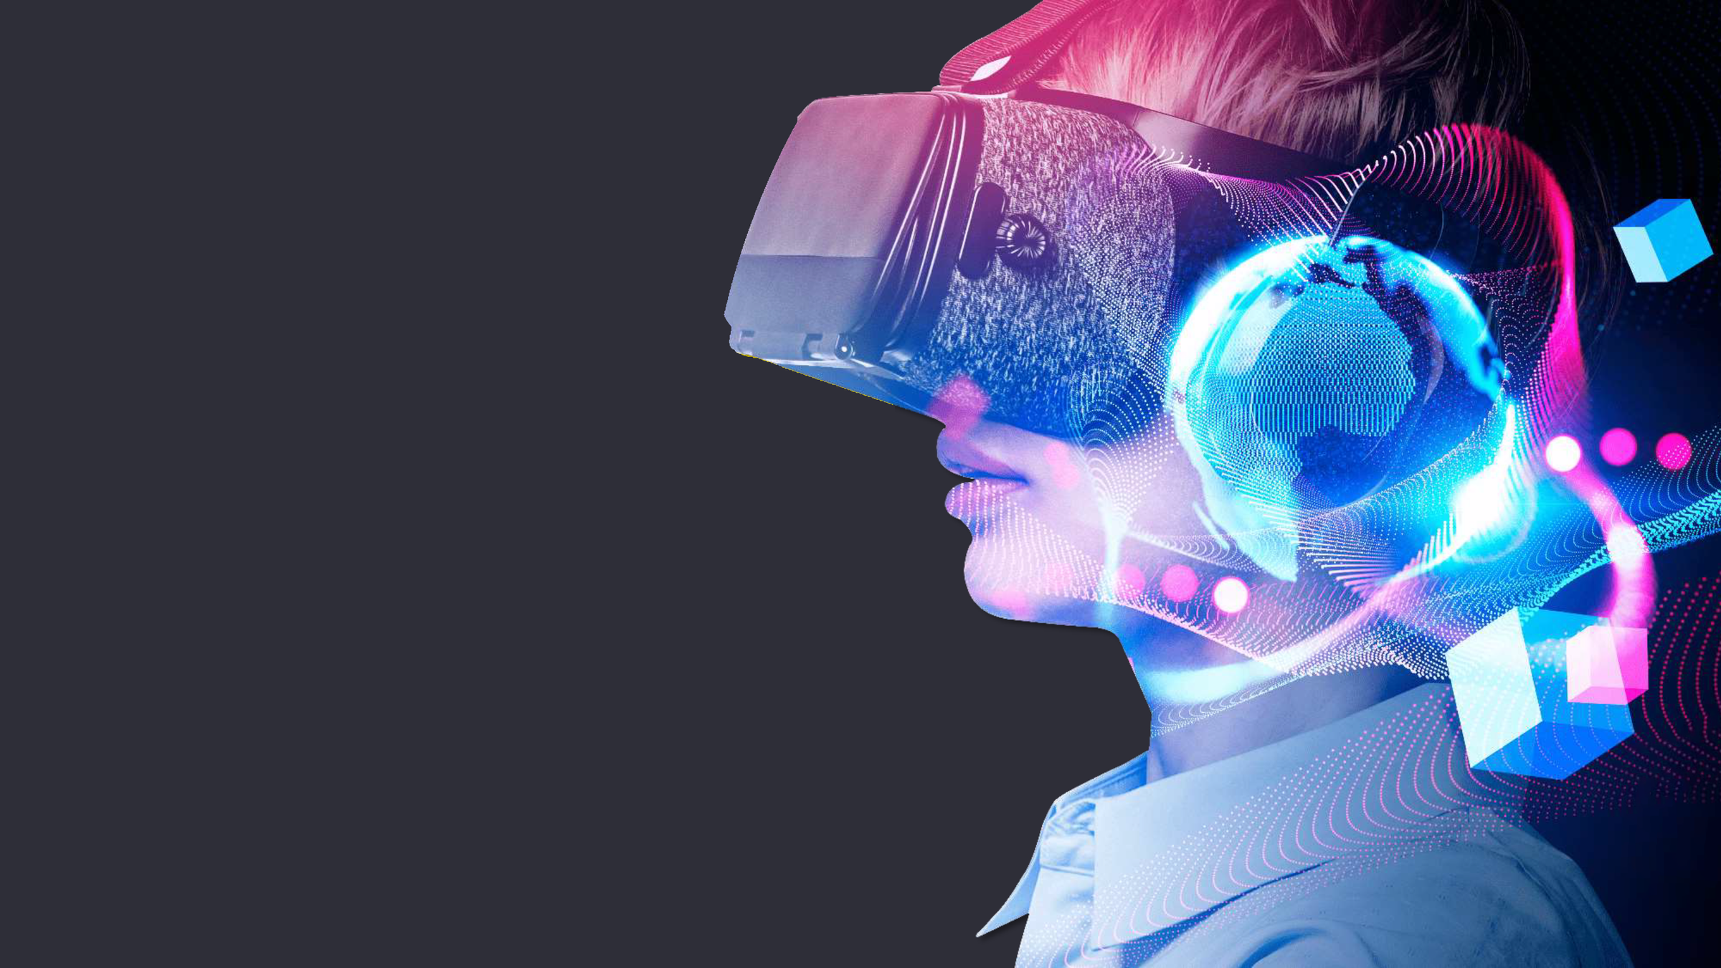
DIGITAL TWIN IN Manufacturing
Team Phasmo Squad

Slide 2
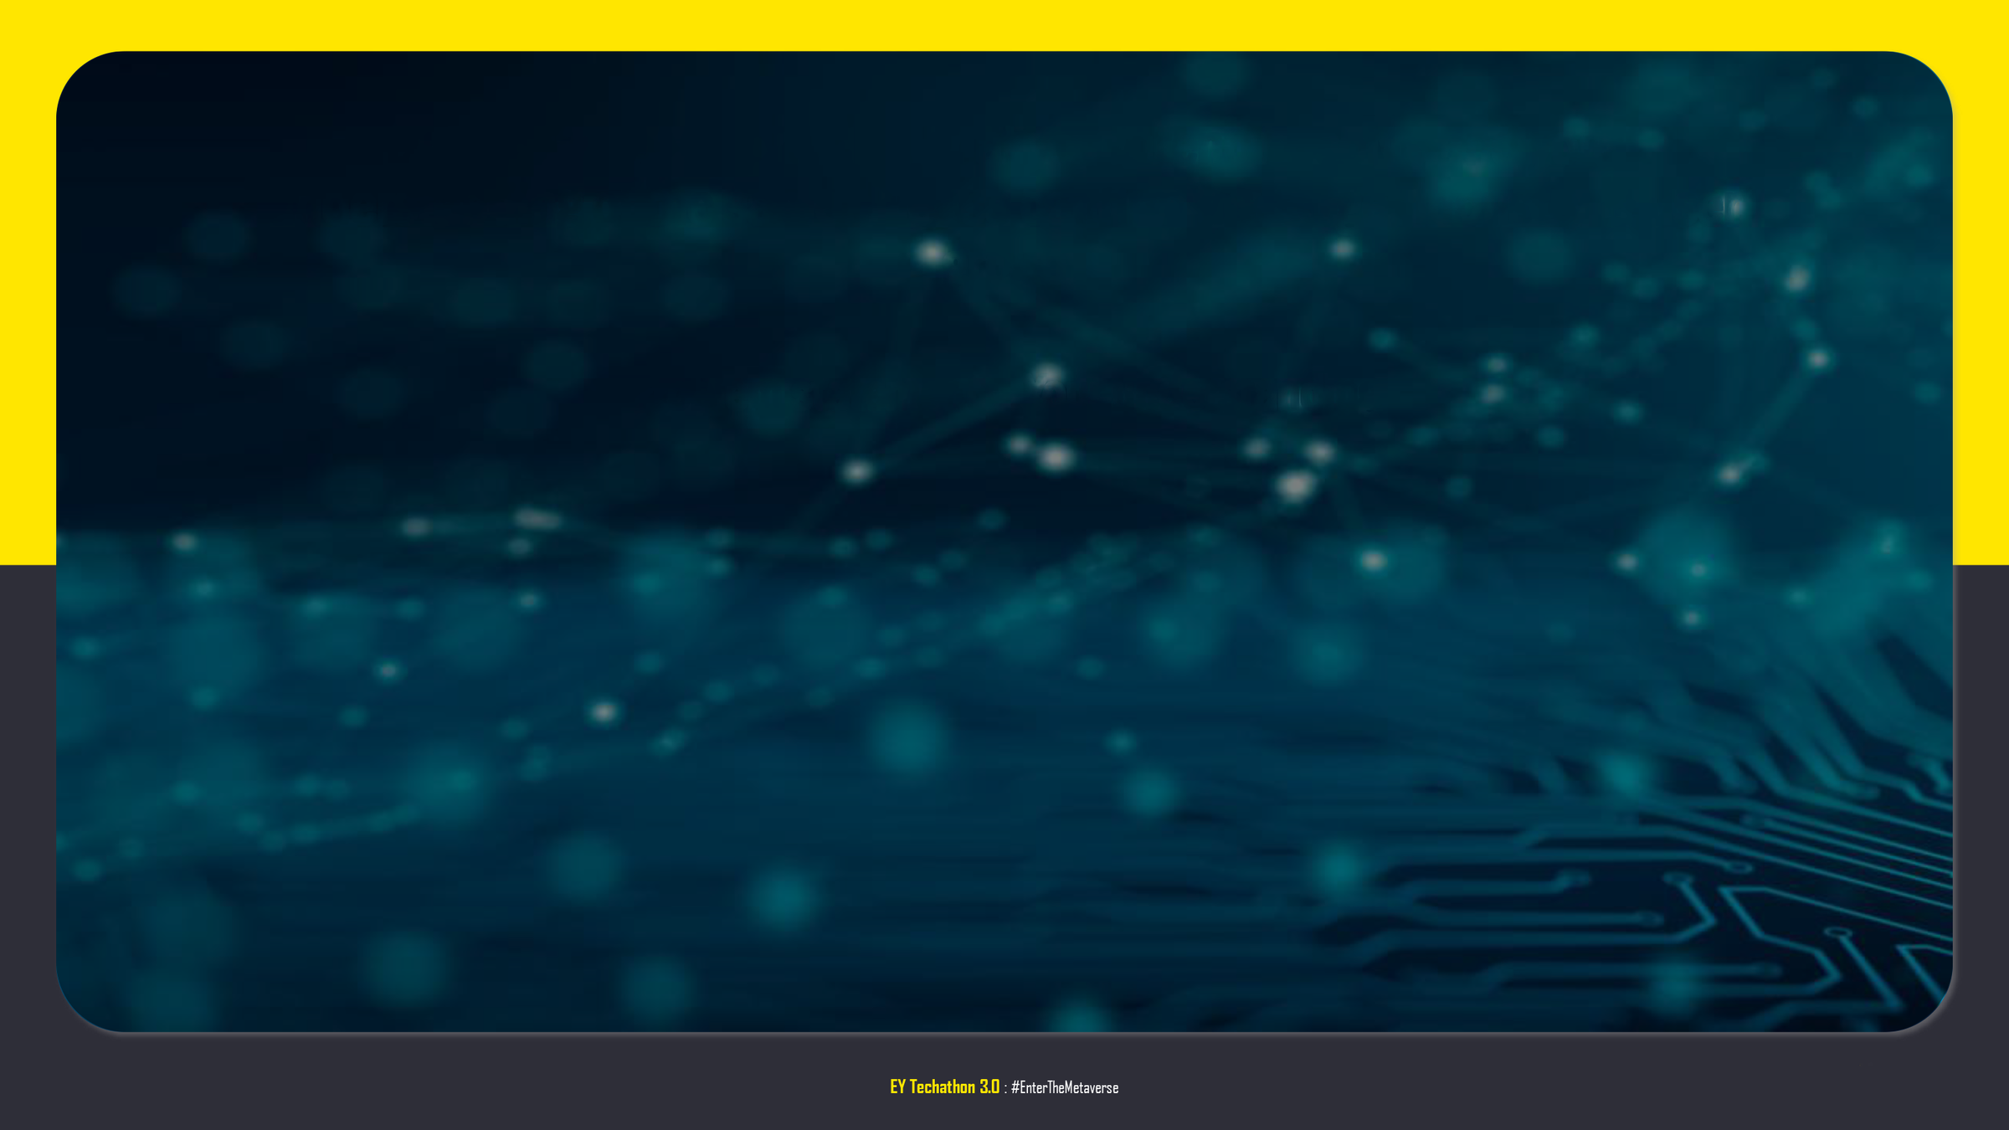
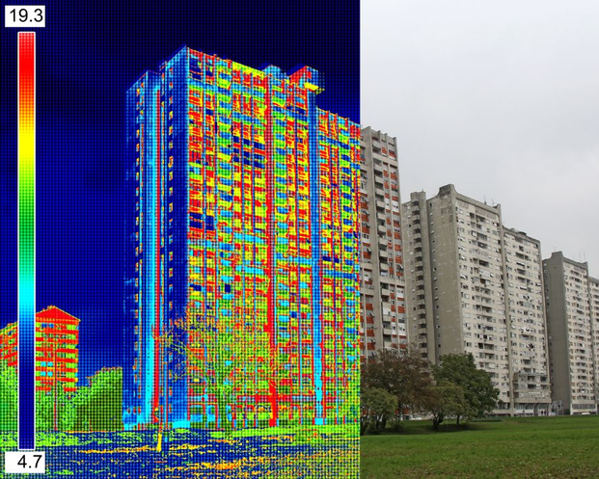
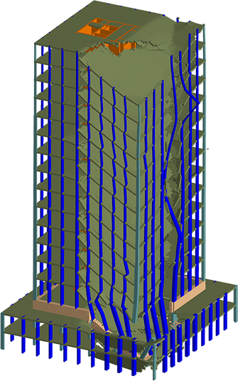
Introduction
Digital twinning in construction improves collaboration, visualization, and planning while enhancing safety and quality control.
Notes:
sumbit
video
app
ppt
github
b/w 1 and 2 team comp with pictures

Slide 3




Our Team
Aaryan M Sandeep
Hari Ganesan
Karthik Nair
Sushanth Nair
Notes:
sumbit
video
app
ppt
github
b/w 1 and 2 team comp with pictures

Slide 4



Problem statement:
The modern civil construction industry is challenged with:
A high level of design accuracy and proper execution process. Post-construction, maintenance, and renovation are made more difficult because of mismanagement.
Construction delay due to miscommunication.

Slide 5
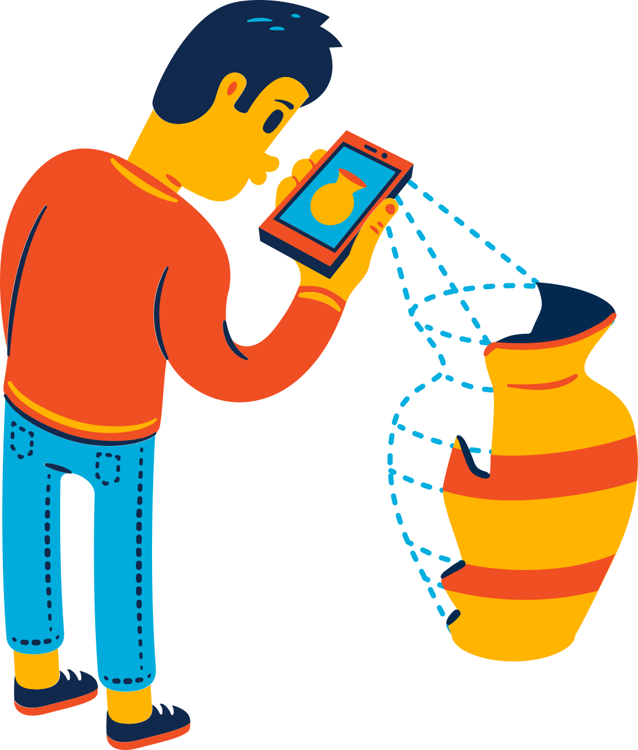
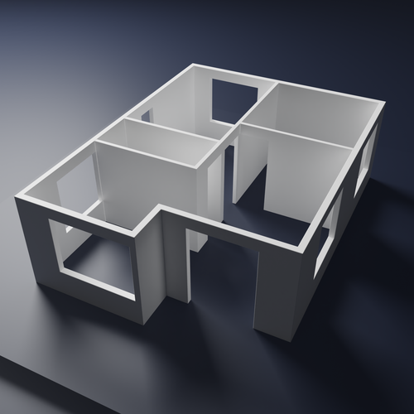
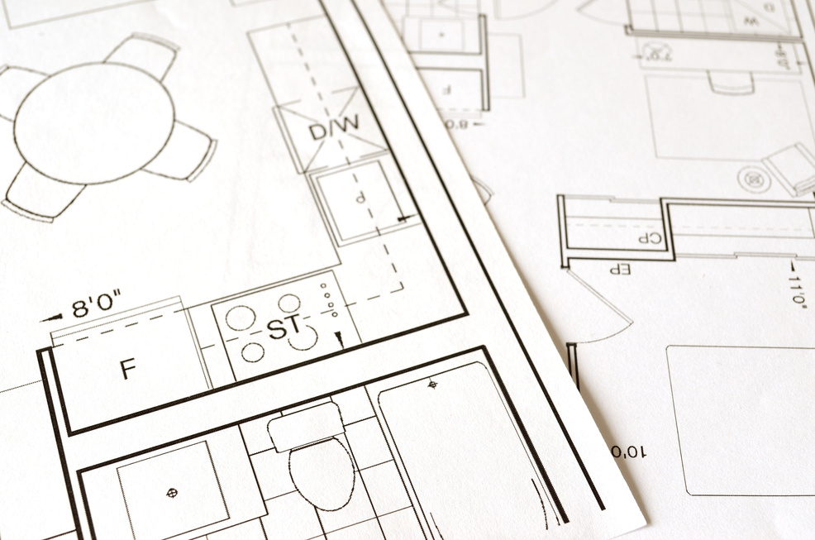
Product Coverage:
Construction integrity
An AR interface that can be overlayed on-site and built over. Focussing on real-time simulation and redesign tools, the interface ensures the entire process of designing doesn’t have to be redone in case of any hurdles.
Maintenance
The 3D design of the building is modeled and imported into the app which will also include plumbing and electrical systems, consequently, during maintenance, the worker has an “X-ray” vision of the aforementioned components behind the wall, augmented on their screen.
A digital twin of the site
Architects and engineers can lay out plans in manufacturing plants, renovate, optimize production and observe otherwise invisible systems. By having a tangible digital twin, productivity is increased.

Slide 6
Product Demonstration:

Slide 7
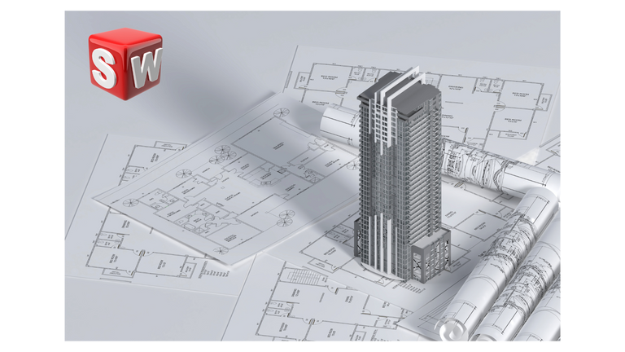
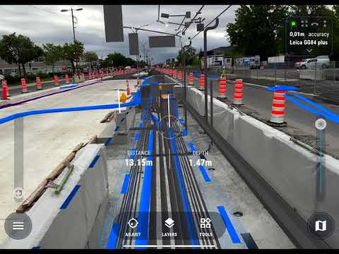

Development concept

Slide 8
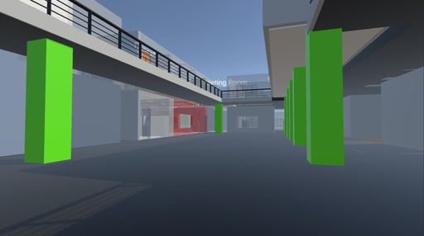
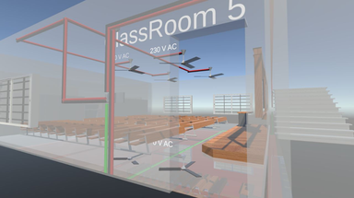
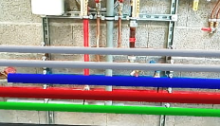
Benefits
Error due to miscommunication is reduced drastically
The construction process becomes more precise and intuitive
General purpose maintenance becomes a lot easier
Floor planning and organization is more streamlined,
which makes management easier
Troubleshooting and diagnosis of problems is faster
Features
Real time Simulation
25T
25T
25T
25T
25T
Digital twinning
Augmented Reality
Notes:
add benefits to this
don't make scalability a separate slide make it benefits

Slide 9





Future Plans
Integration of existing simulation software directly into an AR API.
Partnership with potential construction firms to expand our product.
Adding real-time features which allow for remote work of engineers and architects
Ability to tweak simulations on the AR interface itself

Slide 10
Q n A

Slide 11
THANK YOU

